Slide 1
Capstone Project - 2
Seoul Bike Sharing Demand Prediction Team Members Shreedarsh M Sachin S Panchal Ranjith K Rohan A G Kshipra Parihar

Slide 2
Contents :
Phase 1
EDA
Data Exploration
Data Analysis
Checking Outliers
Outlier treatment
Correlation heatmap
Removing multicollinearity
Phase 2
Modelling
Linear Regression
Polynomial Regression
Random Forest Regressor
Hyperparameter Tuning
Phase 3
Regression Evaluation Metrics
Mean squared error
Mean Absolute error
Root mean squared error
R2 score
comparision

Slide 3
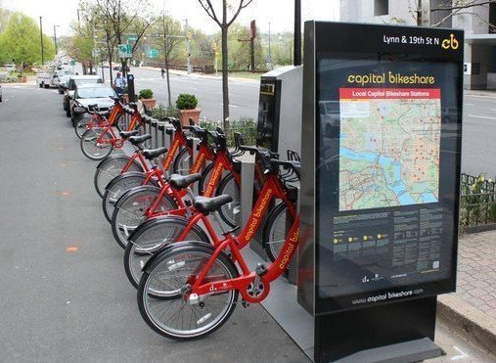
Introduction
Currently Rental bikes are introduced in many urban cities for the enhancement of mobility comfort. It is important to make the rental bike available and accessible to the public at the right time as it lessens the waiting time.
Eventually, providing the city with a stable supply of rental bikes becomes a major concern. The crucial part is the prediction of bike count required at each hour for the stable supply of rental bikes
The dataset contains weather information (Temperature, Humidity, Windspeed, Visibility, Dewpoint, Solar radiation, Snowfall, Rainfall), the number of bikes rented per hour and date information.

Slide 4
Attribute Information
Date : year-month-day
Rented Bike count - Count of bikes rented at each hour
Hour - Hour of he day
Temperature-Temperature in Celsius
Humidity - %
Windspeed - m/s
Visibility - 10m
Dew point temperature - Celsius
Solar radiation - MJ/m2
Rainfall - mm
Snowfall - cm
Seasons - Winter, Spring, Summer, Autumn
Holiday - Holiday/No holiday
Functional Day - NoFunc(Non Functional Hours), Fun(Functional hours)

Slide 5
Problem Statement
The project goal is to predict number of rental bikes required at a particular time of the day.

Slide 6
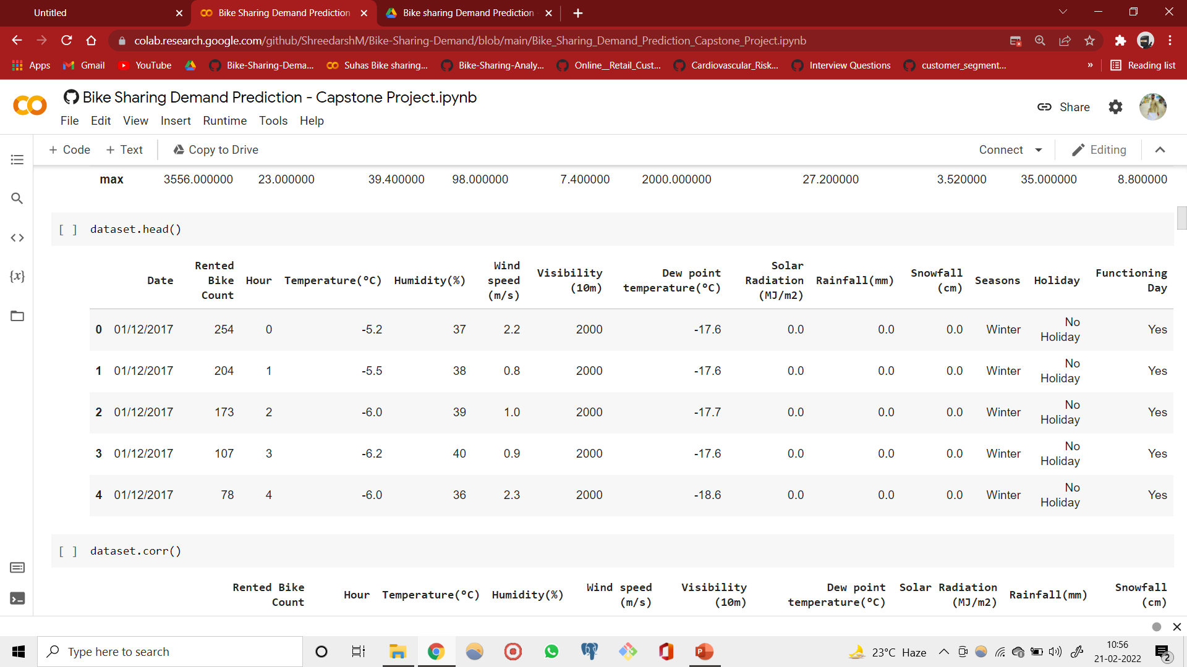
Exploratory Data Analysis

Slide 7
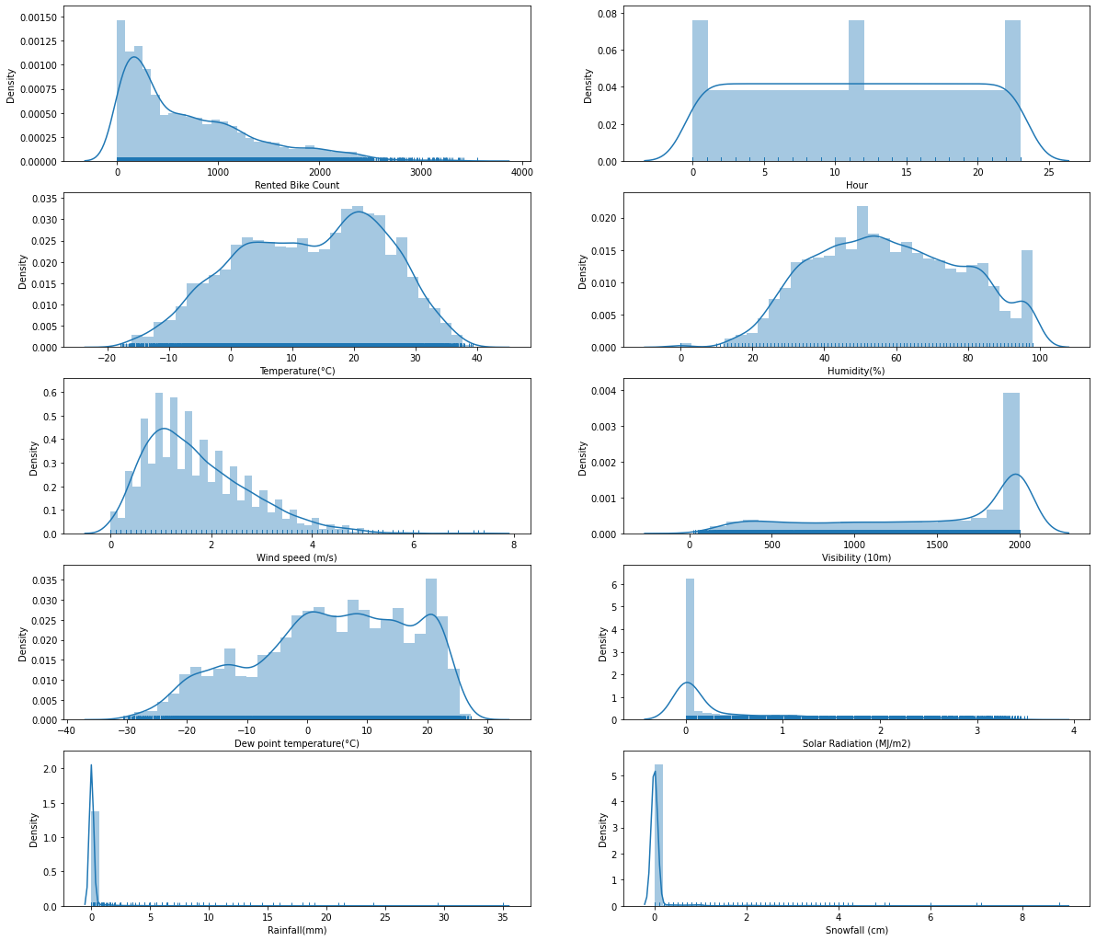
Exploratory Data Analysis

Slide 8
Exploratory Data Analysis

Slide 9
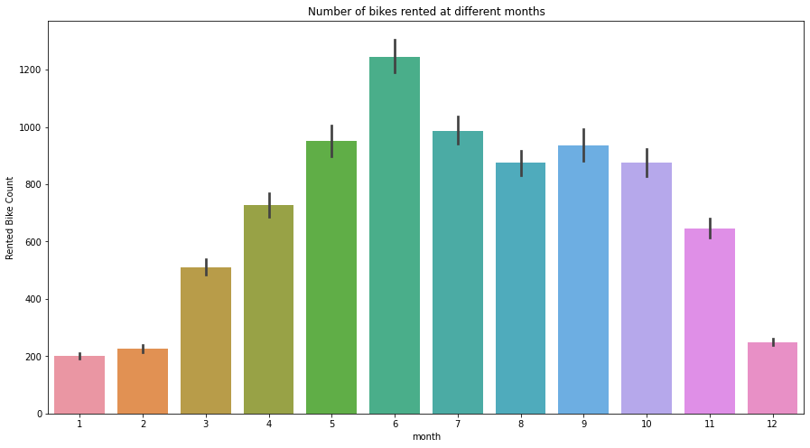
Exploratory Data Analysis

Slide 10
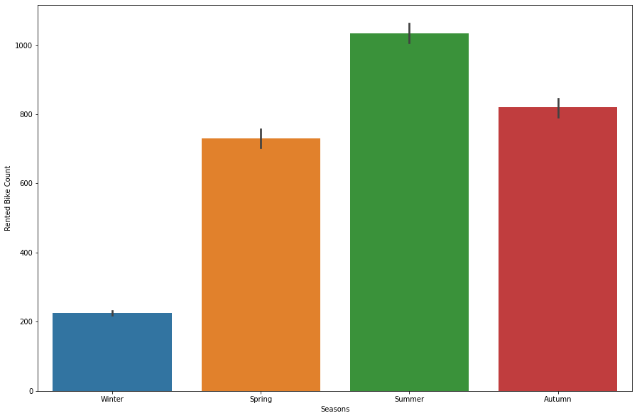
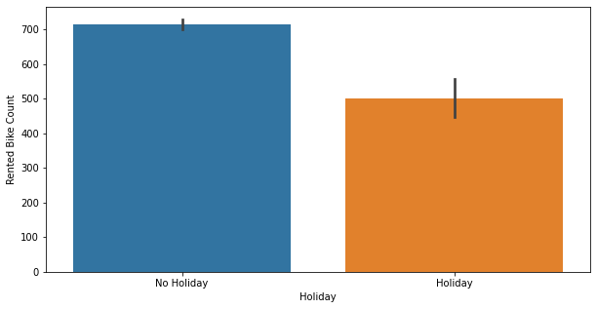
Exploratory Data Analysis
Bike counts vs Seasons
Bike counts vs Functionality day

Slide 11
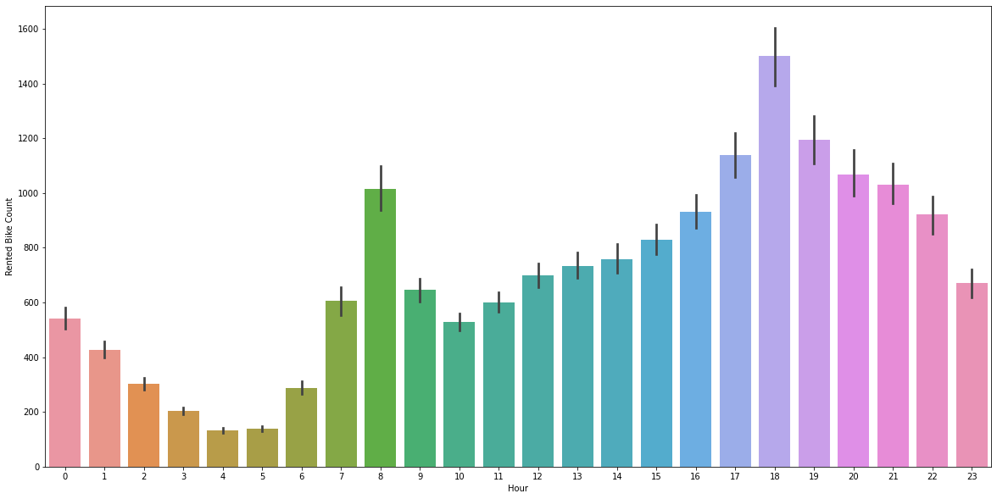
Exploratory Data Analysis
Rented Bike counts across different hours in a day

Slide 12
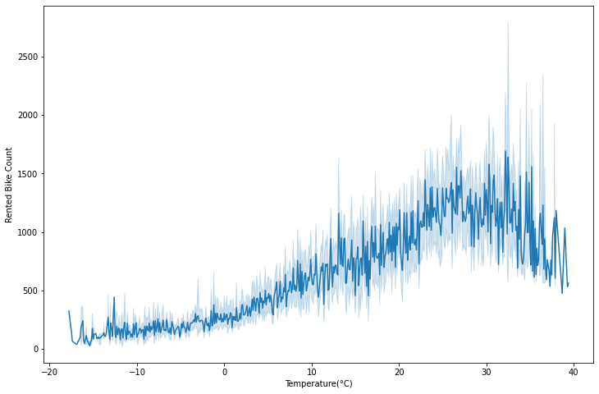
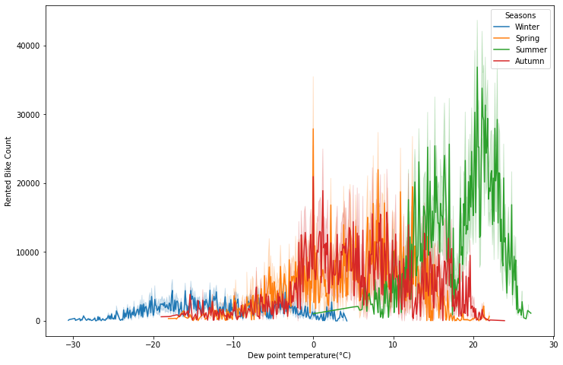
Exploratory Data Analysis
Bike counts vs Temperature
Bike counts vs Dew point temperature

Slide 13
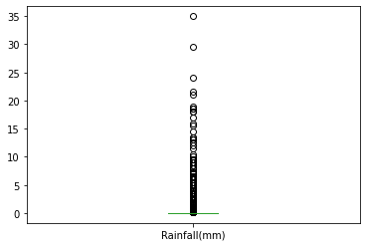
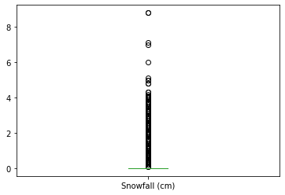
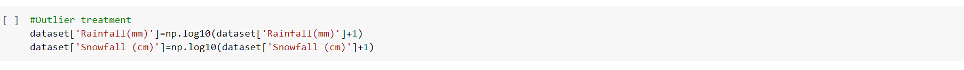
Outliers detection and treatment

Slide 14
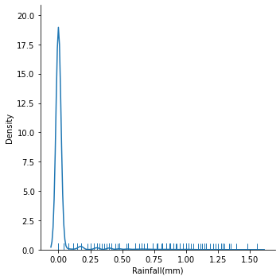
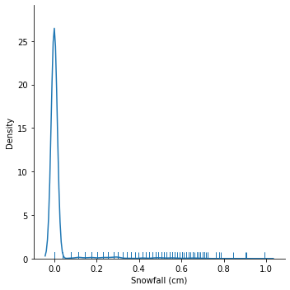
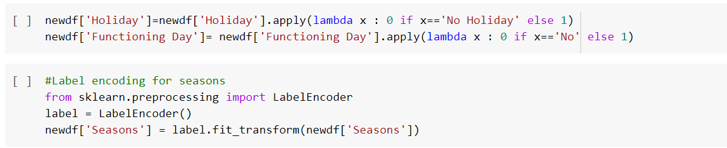
Label Encoding

Slide 15
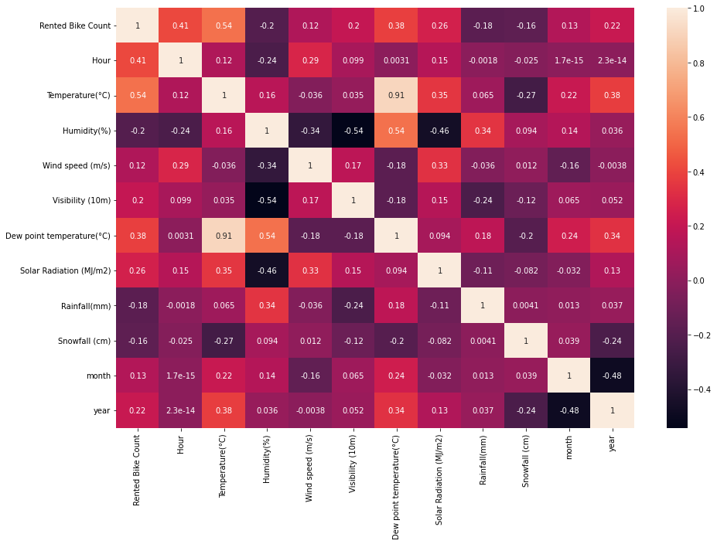
Correlation Heatmap

Slide 16
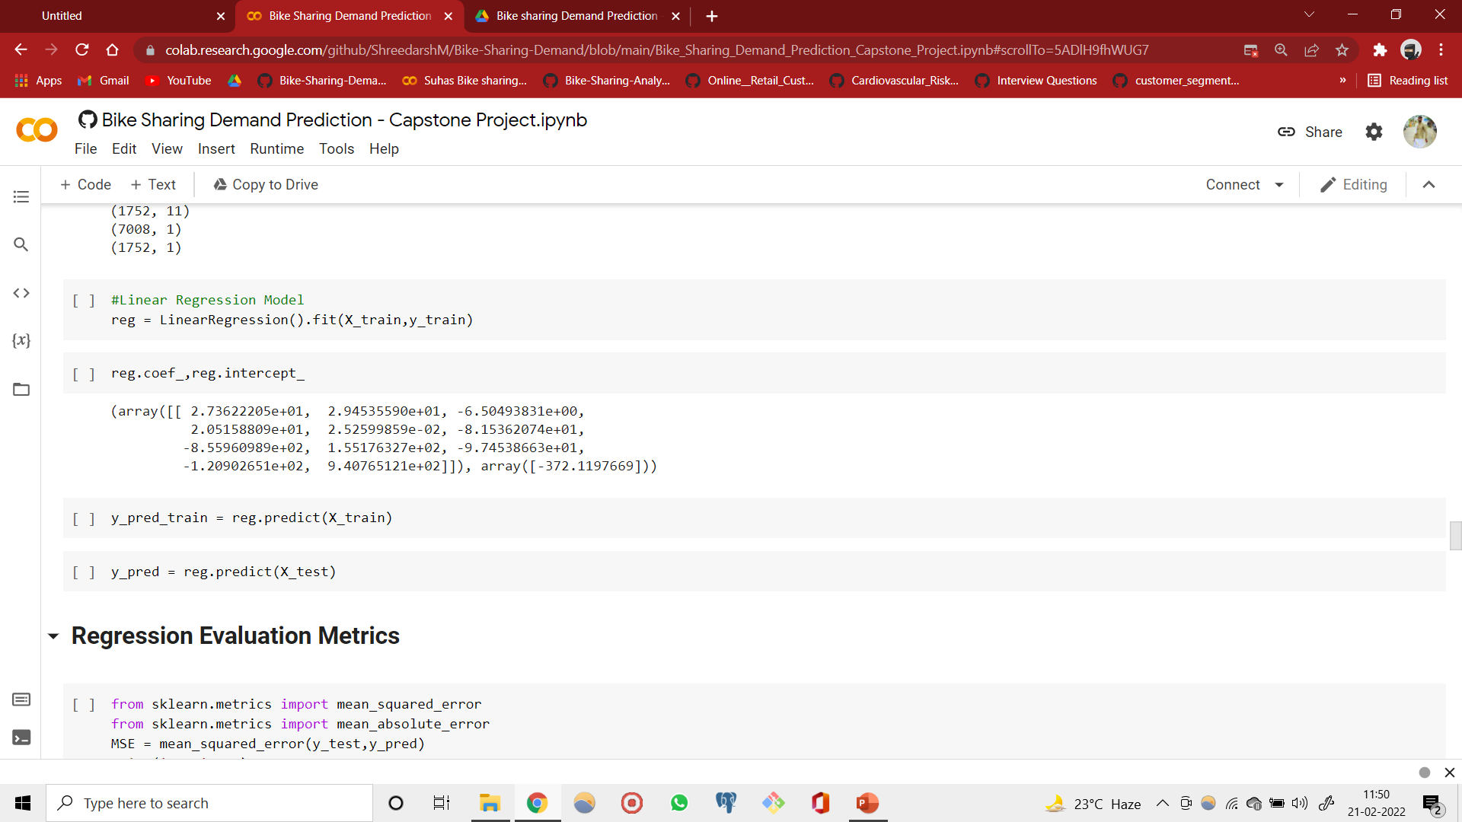
Machine Learning Modelling
1. Linear Regression
Linear regression is a linear model, e.g. a model that assumes a linear relationship between the input variables (x) and the single output variable (y).
Different techniques can be used to prepare or train the linear regression equation from data, the most common of which is called Ordinary Least Squares. It is common to therefore refer to a model prepared this way as Ordinary Least Squares Linear Regression or just Least Squares Regression.

Slide 17
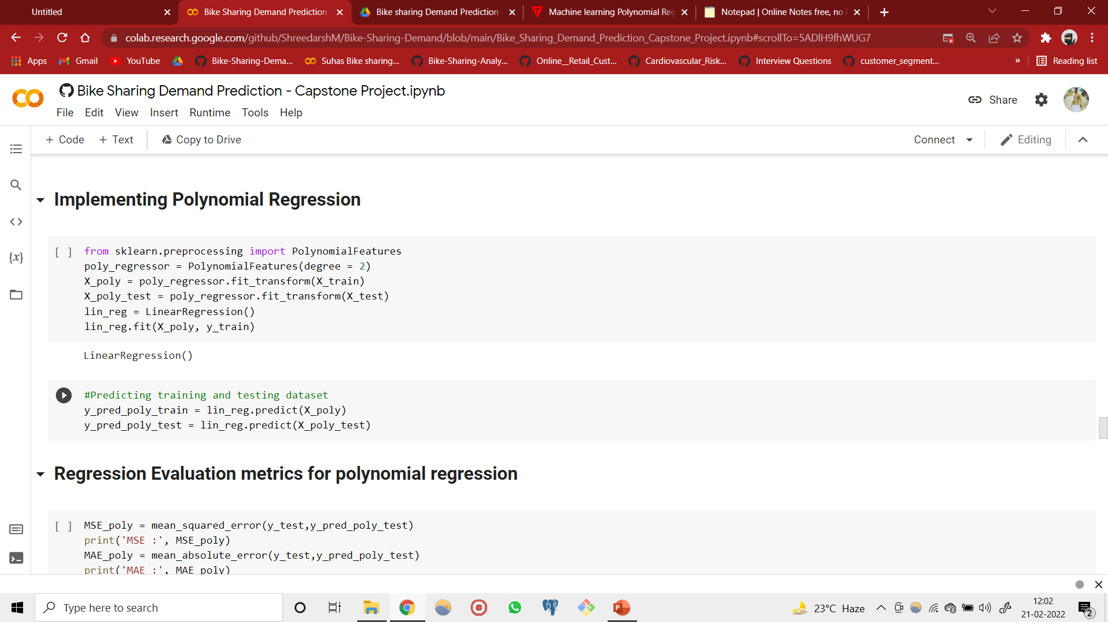
Machine Learning Modelling
2. Polynomial Regression
Polynomial Regression is a regression algorithm that models the relationship between a dependent(y) and independent variable(x) as nth degree polynomial.
It is also called the special case of Multiple Linear Regression in ML. Because we add some polynomial terms to the Multiple Linear regression equation to convert it into Polynomial Regression,
It is a linear model with some modification in order to increase the accuracy.
The dataset used in Polynomial regression for training is of non-linear nature.
It makes use of a linear regression model to fit the complicated and non-linear functions and datasets.
Hence, "In Polynomial regression, the original features are converted into Polynomial features of required degree (2,3,..,n) and then modelled using a linear model."

Slide 18

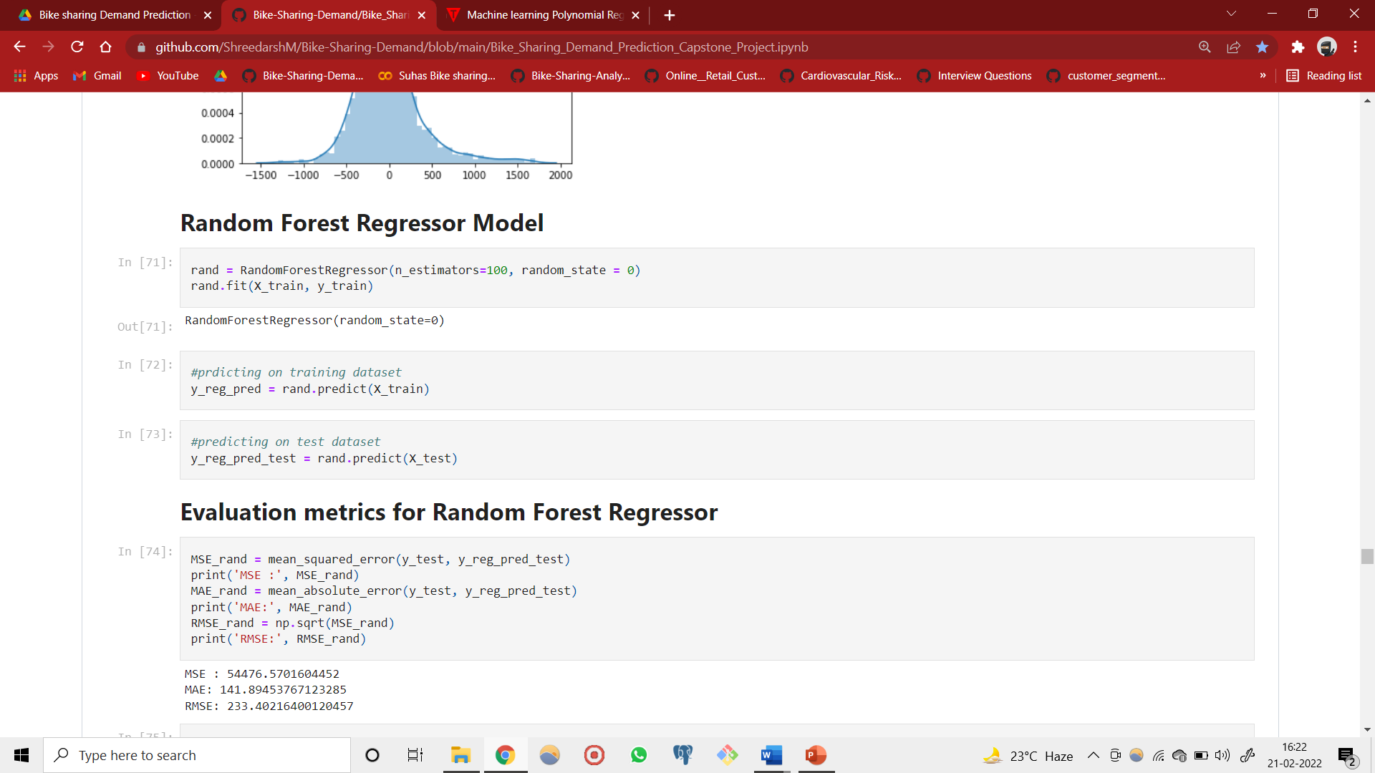
Machine Learning Modelling
3.Random Forest Regressor
Random Forest is a popular machine learning algorithm that belongs to the supervised learning technique. It can be used for both Classification and Regression problems in ML.
It is based on the concept of ensemble learning, which is a process of combining multiple classifiers to solve a complex problem and to improve the performance of the model.
Random Forest is a classifier that contains a number of decision trees on various subsets of the given dataset and takes the average to improve the predictive accuracy of that dataset.
Instead of relying on one decision tree, the random forest takes the prediction from each tree and based on the majority votes of predictions, and it predicts the final output.
The greater number of trees in the random forest leads to higher accuracy and prevents the problem of overfitting.

Slide 19
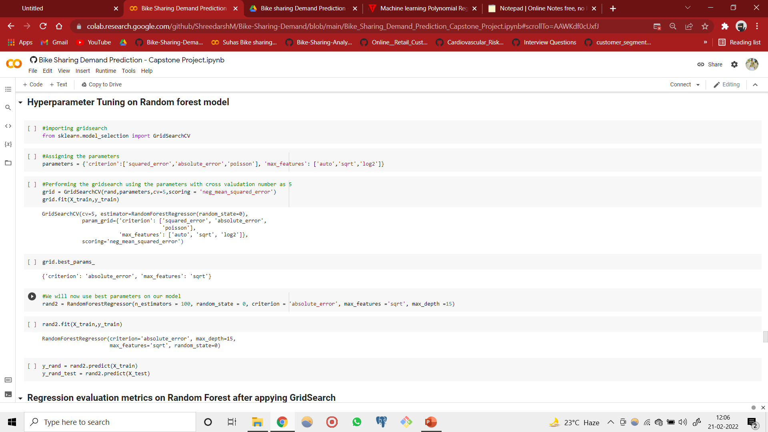
Machine Learning Modelling
Hyper-parameter Tuning

Slide 20
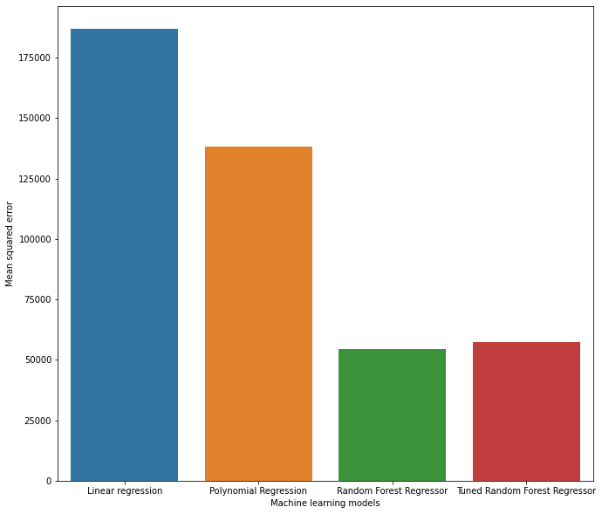
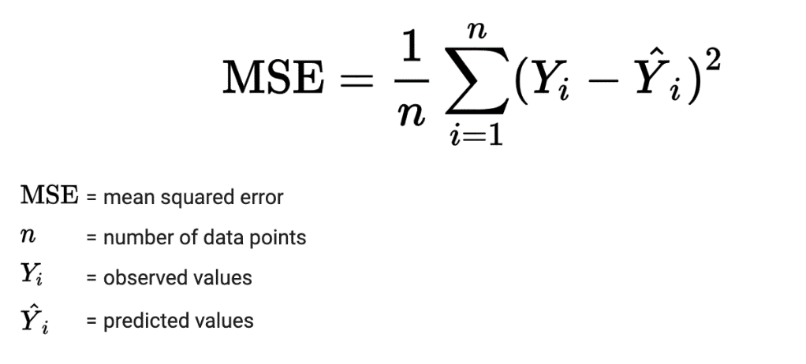
Regression Evaluation Metrics
Mean Squared Error

Slide 21
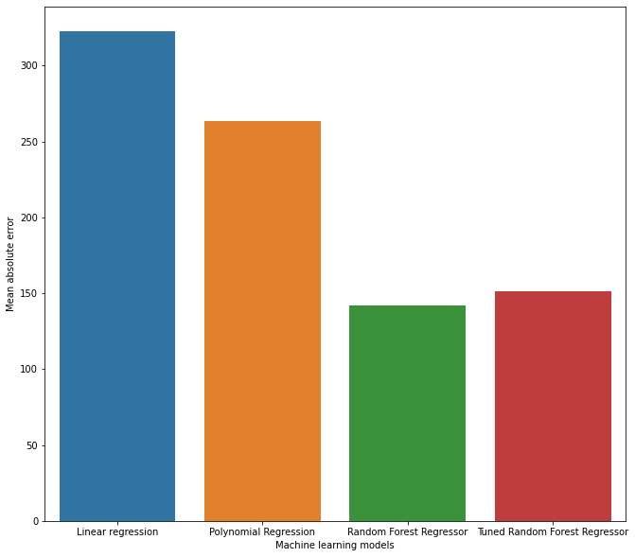
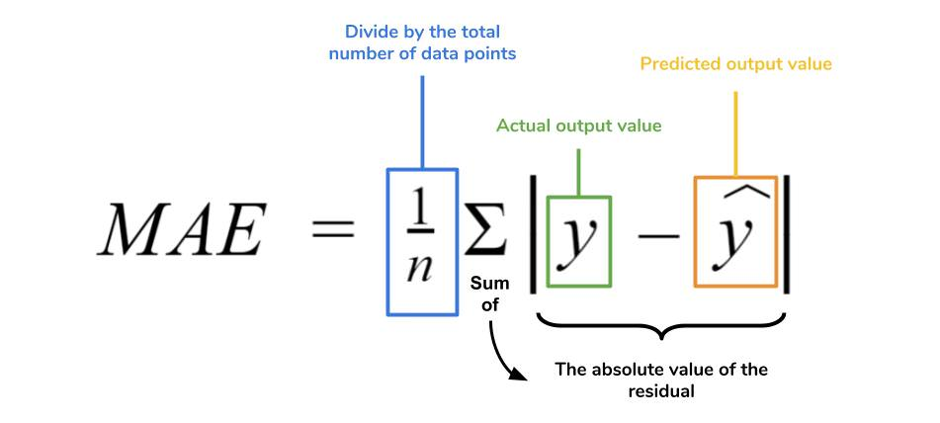
Regression Evaluation Metrics
Mean Absolute Error

Slide 22
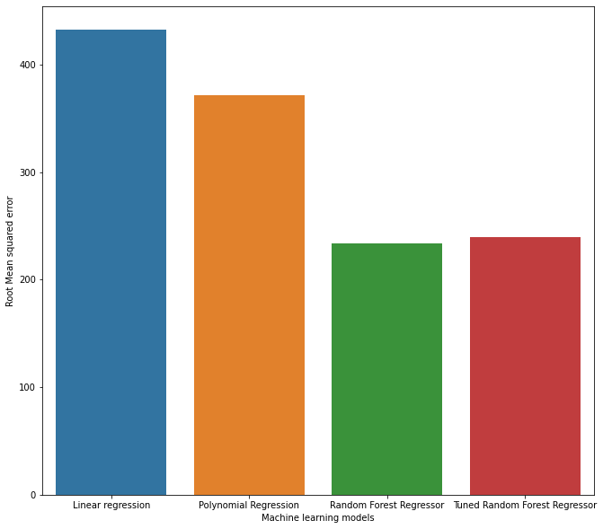
Regression Evaluation Metrics
Root Mean Squared Error

Slide 23
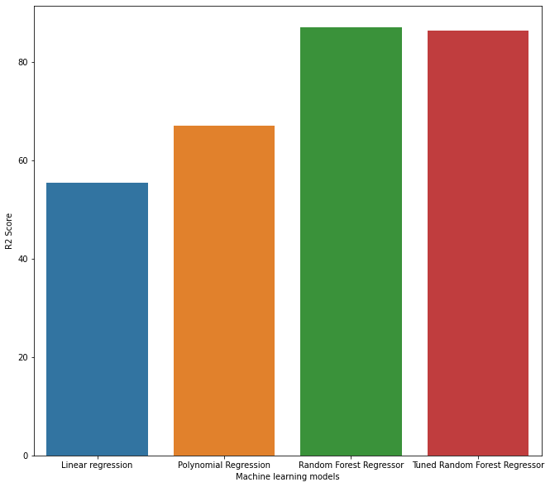
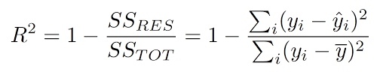
Regression Evaluation Metrics
R2 Scores

Slide 24
Conclusion
We have used three regression models in our analysis to predict the rented bike count that are Linear Regression, Polynomial Regression and Random Forest Regressor.
We have used Hyperparameter tuning on Random forest regressor using GridSearchCV to find the best parameters.
Random Forest Regressor is the best model among the three with least errors and highest R2 score of 98.21% for training set and 86.98% for test dataset.
The peak time is 6pm where highest number of bookings are rented.
Approximately between 10 degree Celsius to 20 degree Celsius the rent booking is peak.
Number of bookings are very much higher in Summer season.
'Rainfall' and 'Snowfall' has a huge impact on number of bikes rented.
Bike renting is high on Functional days (i.e. No holiday).

Slide 25
References
1). https://pandas.pydata.org/
2). https://matplotlib.org/
3). https://seaborn.pydata.org/
4). Geek for geeks

Slide 26
Thank You

